Slide 1
Date: 8th March,2025
Visualizing cellular networks for transit infrastructure
NEW CANVAS
Presented by: Mohammed Syed

Slide 2
AGENDA
Challenge Statement
Coverage Visualization
Objectives
Score Calculation
Data Preprocessing
Repeater Placement Algorithm
Exploratory Data Analysis
Comparative Analysis

Slide 3


CHALLENGE
STATEMENT
Challenge name:
Bus Division Cellular Coverage Study
Organization Name: GL Communications, Inc.
Challenge Partner: Dr. Kam Yee
Challenge Summary
A certain transit agency is interested in evaluating and comparing robustness and reliability of cellular communication link from three different cellular service providers in one of its indoor bus maintenance facilities.
GL Communications collected data that measures the performance for coverage and data throughput. The objective is to compare cellular carriers’ performance, verify adequate cellular data coverage, and identify any major coverage gaps.

Slide 4
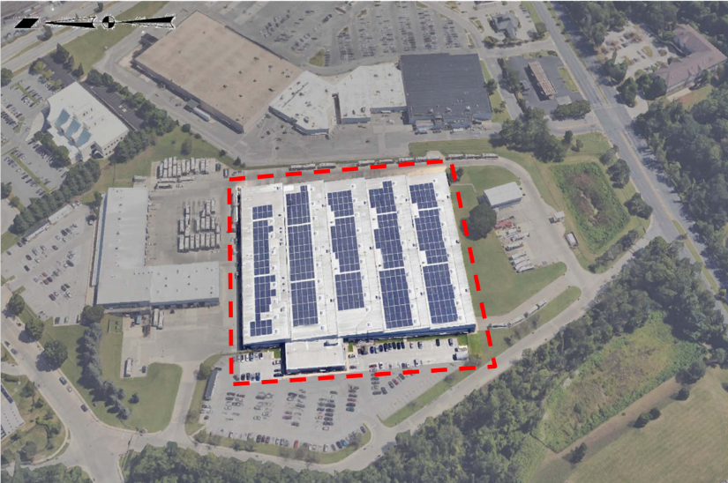
CHALLENGE OBJECTIVES
Objective 1
Compare cellular carrier’s performance
Objective 2
Verify cellular data coverage and identify any major coverage gaps
Objective 3
Provide recommendation on where to add cellular repeaters within the facility to close major coverage gaps

Slide 5
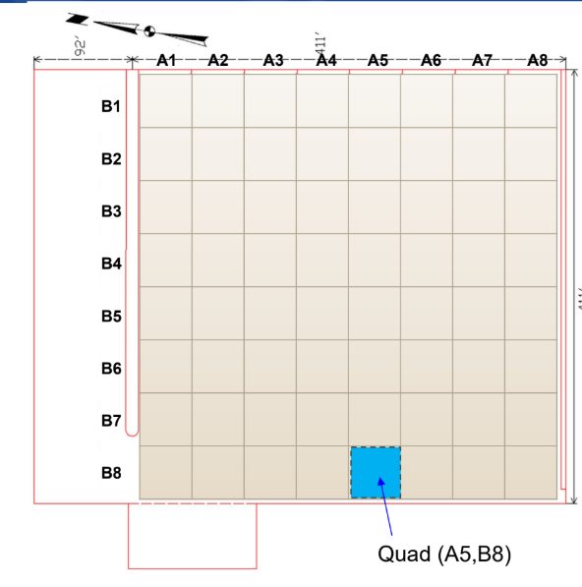
UNDERSTANDING THE DATA
The facility is subdivided into a grid of 8x8
Quads
8 Aisles across (A1-A8)
8 Blocks per aisle (B1-B8)
So, there are (8*8) 64 Quads in the facility

Slide 6
Dataset
Three datasets are provided, each containing seven columns:
Aisle Number : Values ranging from A1 to A8
Block Number: Values ranging from B1 to B8
Timestamp – Date and time of test.
RSSI, Received Signal Strength Indicator [dBm]
TCP Upload Speed [Mbps]
TCP Upload Quality of Service (QoS) (%)
TCP Round Trip Time (RTT) [ms]

Slide 7
Key Performance Indicators (KPIs):
We have four KPIs available:
RSSI (Received Signal Strength Indicator) [dBm]
TCP Upload Speed (Data Transmission Rate)[Mbps]
TCP Upload QoS (Quality of Service) [%]
TCP RTT (Round Trip Time) [ms]

Slide 8
Data Preprocessing:
Data preprocessing is the process of cleaning, transforming, and organizing raw data to make it suitable for analysis or modeling.
Challenges:
Null Values
Duplicate Values
Average Approach
Log Scale
Maximum Approach
Normalization + Weights
Inverse Transformation
Check for missing quads (<64)

Slide 9
Exploratory Data Analysis (EDA):
it is the process of analyzing and visualizing data to uncover patterns, detect anomalies, test hypotheses, and summarize key insights.
Challenges:
Histogram for all KPIs using both approaches
Scatterplot
Statistical Analysis
All in one type of plot
Box Plot
Violin Plot
Comparision using violin plot
All of the plots are interactive

Slide 10
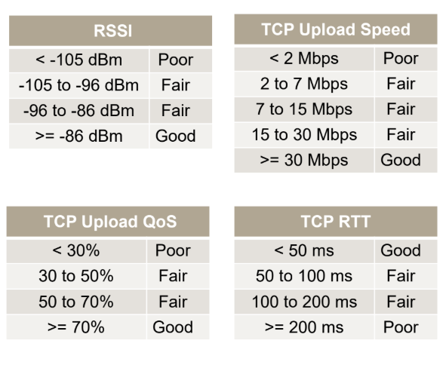
Histogram bins

Slide 11
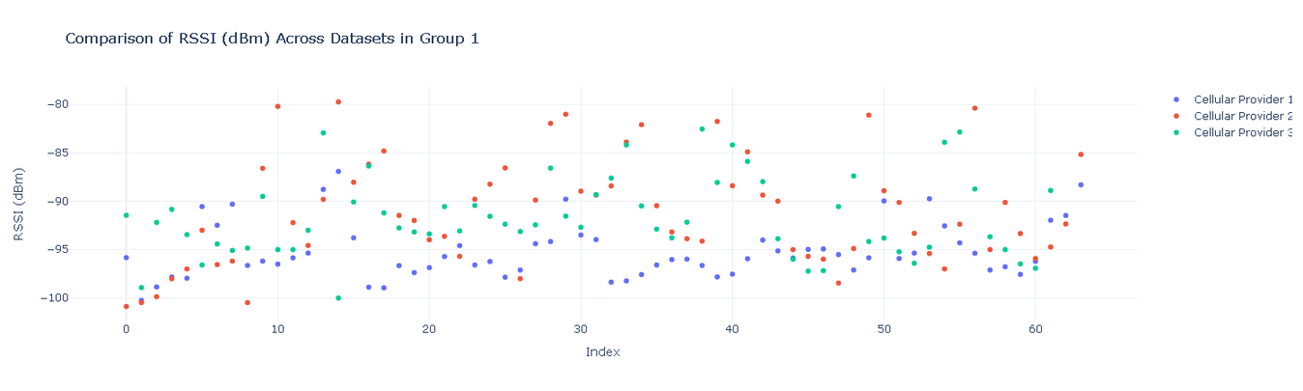
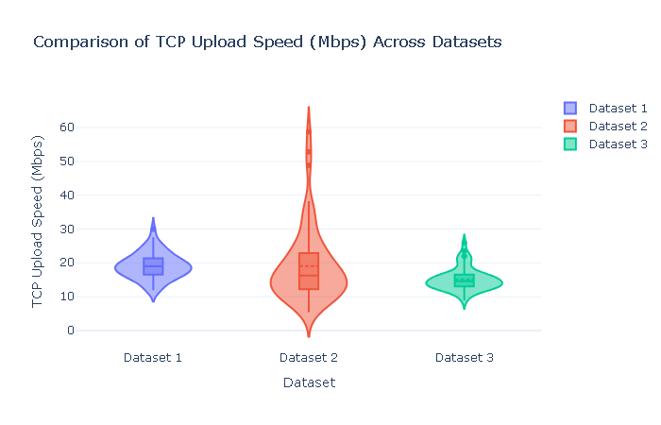
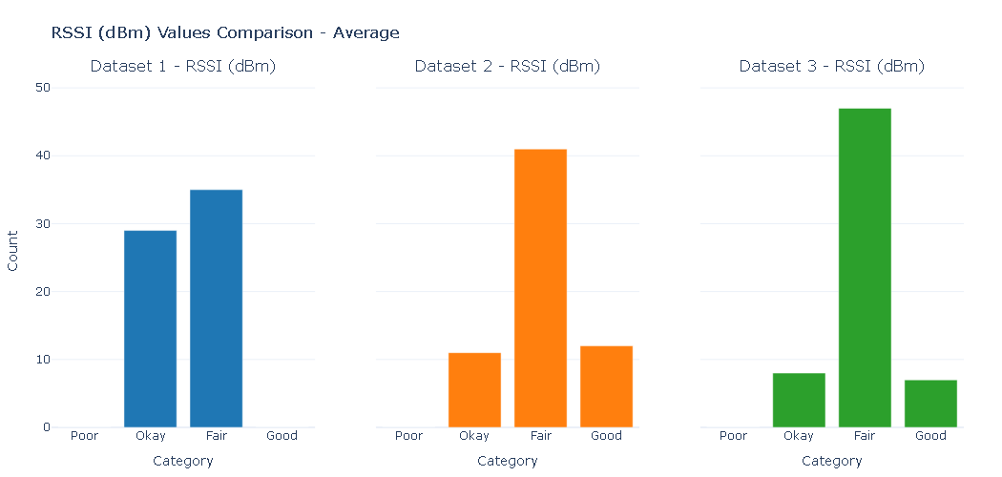
EDA Insights

Slide 12
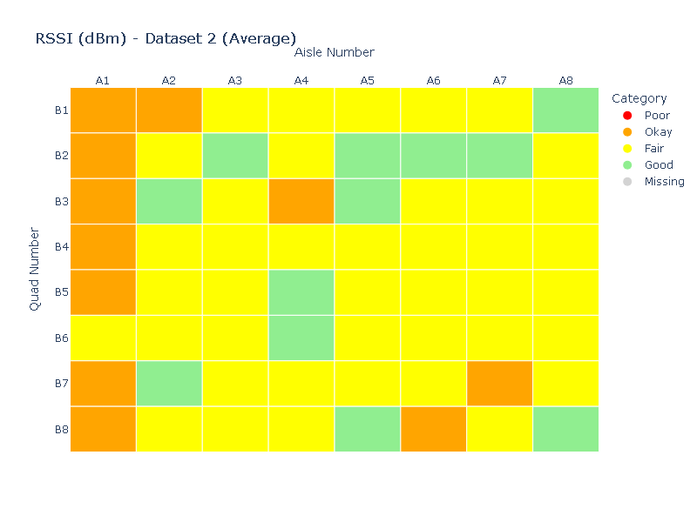
Coverage Visualization
Used an interactive heatmap to show the intensity of each KPI in both approaches across all three datasets.

Slide 13
Score Calculation:
Score = (RSSI Fair+Good %) * 40% + (TCP Upload Speed Fair+Good %) * 40% + (TCP Upload QoS Fair+Good %) * 10% + (TCP RTT Fair+Good %) * 10%
Adjusted Score Calculation
Score = (RSSI Fair+Good %) * 40% + (TCP Upload Speed Fair+Good %) * 40% + (TCP Upload QoS Fair+Good %) * 10% + (TCP RTT Fair+Good %) * 10%
Best Score = (RSSI Good %) * 40% + (TCP Upload Speed Good %) * 40% + (TCP Upload QoS Good %) * 10% + (TCP RTT Good %) * 10%
The metrics were revised as the dataset lacked "Not Poor" values and had multiple "Fair" categories. "Fair" now represents the second-best rating, and a "Best Score" metric was added to compare performance.

Slide 14
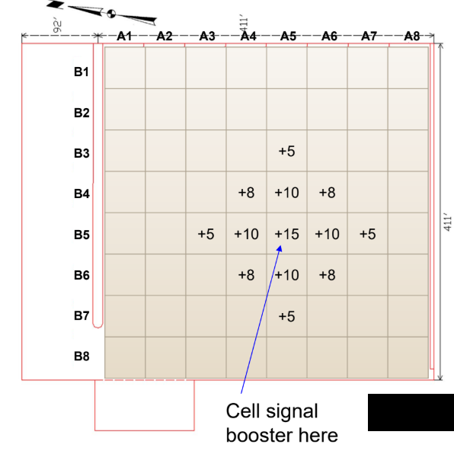
Cell Signal Booster
Small antennas boost andredistribute the signal, as much as 32x stronger*
Rough estimate of increase in dBm shown
32x = 15 dBm increase
10x = 10 dBm increase
6x = 8 dBm increase
3x = 5 dBm increase

Slide 15
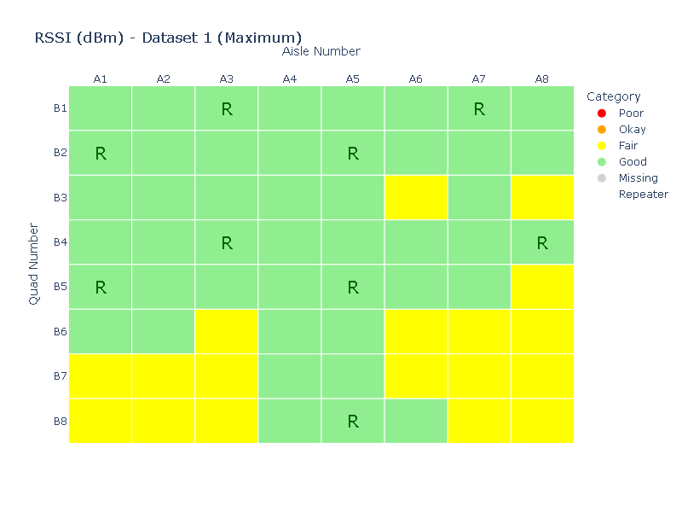
Repeater Placement Algorithm
The min_repeaters function determines the minimum number of repeaters needed to improve weak RSSI signals in a grid. It identifies poor signal locations, places repeaters at the worst spots, and boosts nearby signals based on a predefined map. The function returns the number of repeaters used, their locations, and the updated RSSI values.

Slide 16
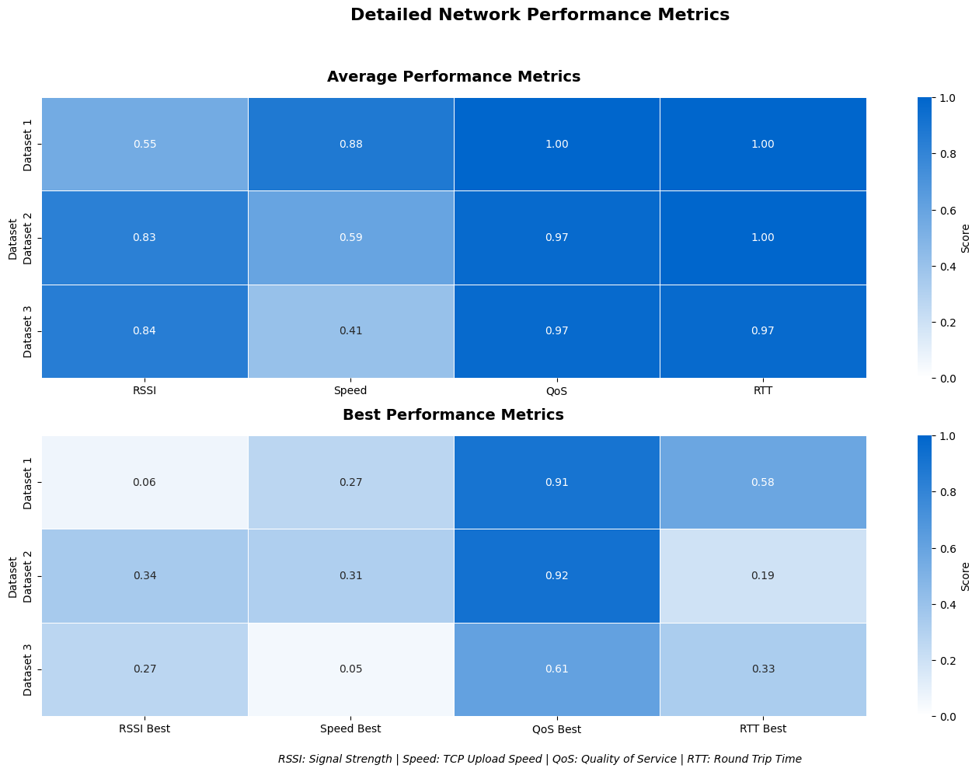
Comparative Analysis
Evaluated carriers using a dual-scoring system across signal strength, speed, QoS, and RTT metrics. The heatmap visualizations show Dataset 1 excels in QoS and RTT reliability, while Dataset 2 provides superior signal strength. Using normalized scores for both average and peak performance scenarios, I calculated weighted metrics that prioritize factors most critical for transit operations, creating a quantitative framework for carrier recommendation.

Slide 17
Date: 8th March, 2025
THANK YOU FOR YOUR ATTENTION
Presented by: Mohammed Syed

